Slide 1

Lecture 4 Conditional Structures

Slide 2
Java - Decision Making
Decision making structures have one or more conditions to be tested by the program,
Along with a statement or statements that are to be executed if the condition is determined to be true,
Optionally, other statements to be executed if the condition is determined to be false.

Slide 3
types of decision making statements.
if statemnet
If…else statement
Nested if else statement
Else..if ladder
Switch statement

Slide 4
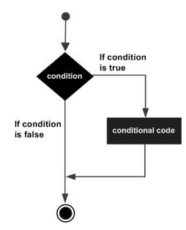
If.. statement
An if statement consists of a Boolean expression followed by one or more statements.
if(Boolean_expression)
{
// Statements will execute if the Boolean expression is true
}

Slide 5
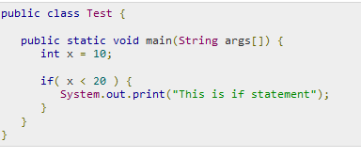

Example

Slide 6
Read age of user and make a decision to print whether age is less than 21 print “ youth is wonderful” otherwise print “ Age is state of mind”
If (age<21)
System.out.println(“ YOUTH IS WONDERFUL”);
System.out.println(“AGE IS STATE OF MIND”);

Slide 7
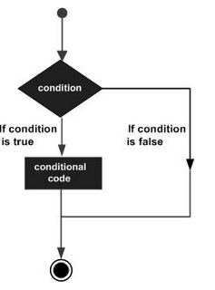

If – else statement
if(Boolean_expression)
{
// Statements will execute if the Boolean expression is true
}
Else
{
// Statements will execute if the Boolean expression is fasle
}

Slide 8
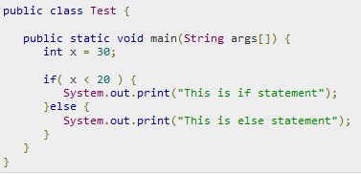
Example

Slide 9
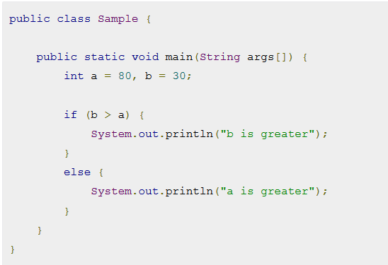
Example

Slide 10
Check input number is odd or even | Even → no %2 ==0 Odd → no%2 !=0 | if ( no%2 ==0) { } else { }
Comparison between two numbers | < , <=, >, >=, == ,!= | if (a <b) if(a>b) if( a<=b) if(a>=b) if( a==b) if (a!=b)
Two conditions |  | if ( no>0 && no<10) if ( no==5 || no==10) if(a>b && a>c)

Slide 11
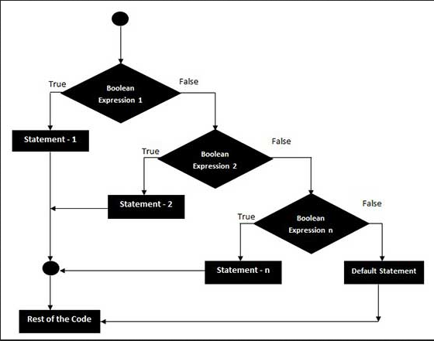
Else…if
very useful to test various conditions using single if...else if statement.

Slide 12
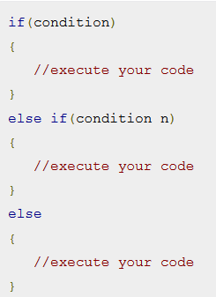
Syntax

Slide 13
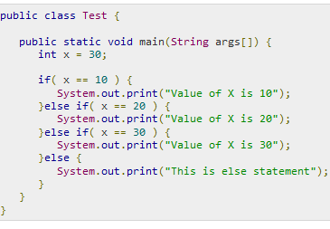
Example

Slide 14
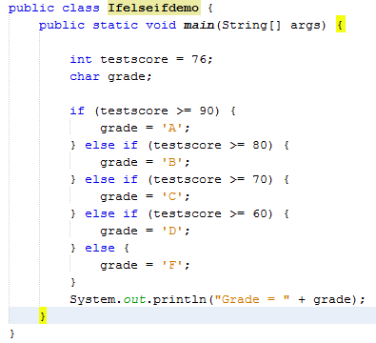
Example

Slide 15
Exercise
Consider the following code snippet.
if (aNumber >= 0)
if (aNumber == 0)
System.out.println("first string");
else
System.out.println("second string");
System.out.println("third string");
What output do you think the code will produce if aNumber is 3?

Slide 16
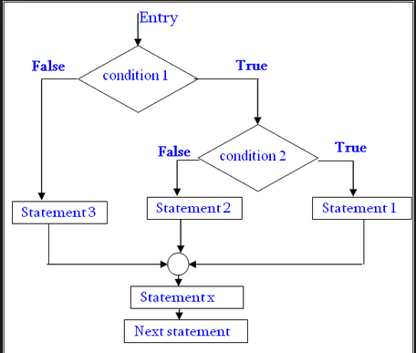
Nested if statements

Slide 17
If (Boolean_expression 1)
{
// Executes when the Boolean expression 1 is true
if(Boolean_expression 2)
{
// Executes when the Boolean expression 2 is true
}
else
{
// Executes when the Boolean expression 2 is false
}
}
else
{
}

Slide 18
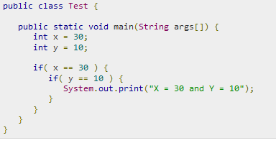

Example

Slide 19
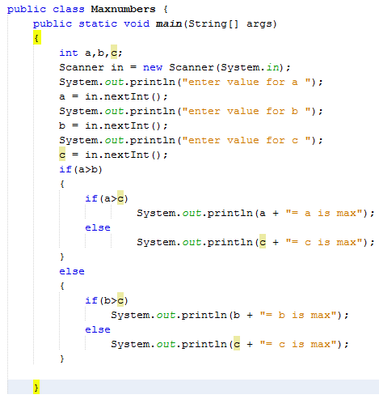
Find the maximum number out of 3 numbers

Slide 20
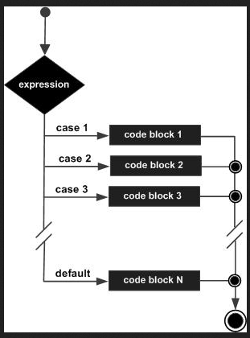
Switch Structure
Its used when you have multiple possibilities for the if statement

Slide 21
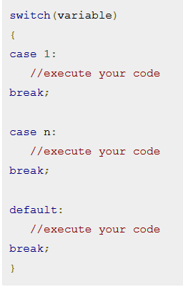
Syntax

Slide 22
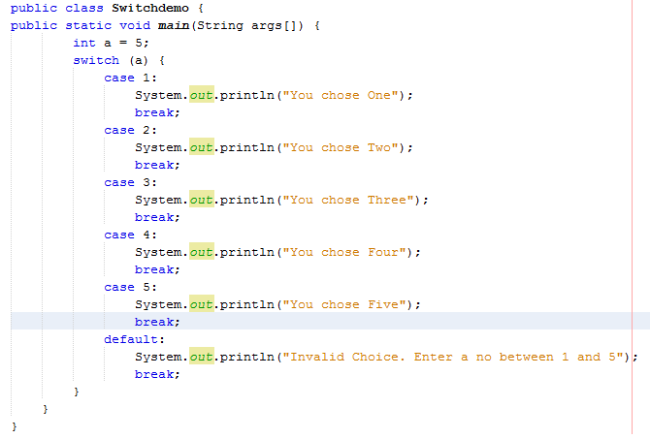
Example

Slide 23
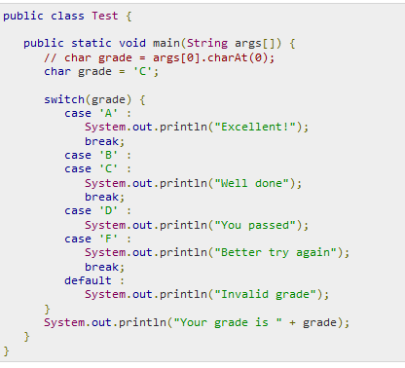
Example

Slide 24
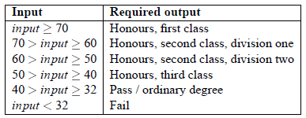
Excercises
Declare an int named month whose value represents a month. The code displays the name of the month, based on the value of month
write a program called DegreeCategory which takes a student mark (e.g. final year, total assessment mark) and reports what degree category it is worth. The input is a single number.

Slide 25
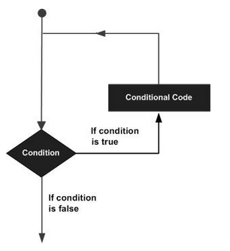
Loop Control
There may be a situation when you need to execute a block of code several number of times.
A loop statement allows us to execute a statement or group of statements multiple time

Slide 26
Types of loop
While loop
Do..while loop
For loop

Slide 27
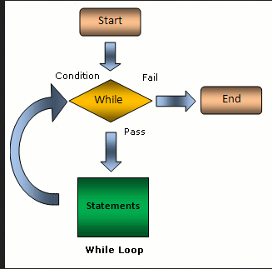
While
In while loop first check the condition
if condition is true
then control goes inside the loop body
otherwise goes outside of the body

Slide 28
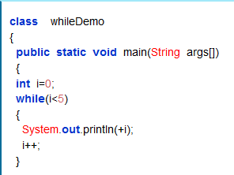

Syntax
while(condition)
{
Statement(s);
Increment / decrements (++ or --);
}

